Slide 1

Capstone Project (python) Loan Issue and Credit Risk analysis
Presented by
Umesh Sangule

Slide 2
Introduction
In general, whenever an individual/corporation applies for a loan from a bank (or any loan issuer), their credit history undergoes a rigorous check to ensure that whether they are capable enough to pay off the loan (in this industry it is referred to as credit-worthiness).
Based on the amount of risk that the issuer is willing to take (plus some other factors) they decide on a cutoff of that score and use it to take a decision regarding whether to pass the loan or not. This is a way of managing credit risk.

Slide 3
Cont. ……
In this project we will have to put ourself in the shoes of a loan issuer and manage credit risk by using the past data and deciding whom to give the loan to in the future.
The data contains the indicator of default, payment information, credit history, etc.

Slide 4
problem statement
We have to build a data model to predict the probability of default, and choose a cut-off based on what we feel is suitable. Alternatively we can also use a modeling technique which gives binary output.
Based on the data that is available during loan application, build a model to predict default in the future. This will help the company in deciding whether or not to pass the loan.

Slide 5
Data Description
Checking Number of Columns and Rows
Number of Rows = 855969
Number of Columns = 73
Y- Variable(Target)
“default_ind”
Variables Details(data types):
Integer64 = 4
Float64 = 49
Object = 21

Slide 6
Exploratory Data Analysis:
Checking Null values in dataset
Filter Columns with Null values greater than 74% in variables
Removing columns having more null values
Handling Null values by Imputation method using Domain Knowledge Comparison

Slide 7
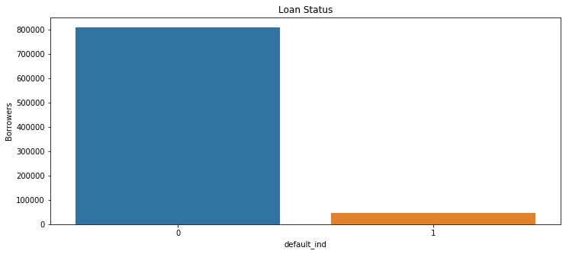
data projection:(Target Variable)

Slide 8
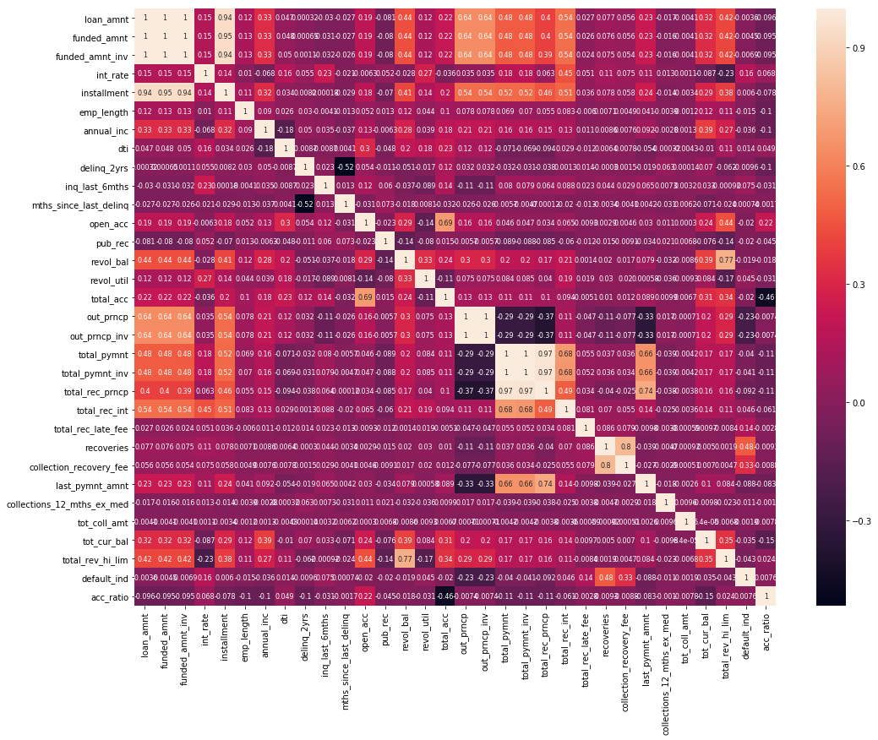
Cont….(Correlation)

Slide 9
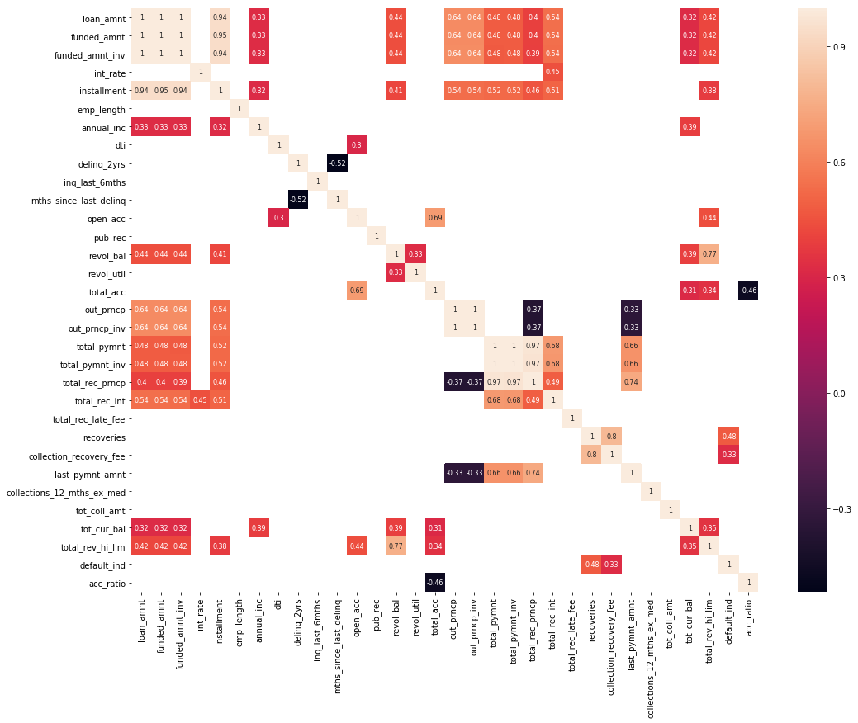
Cont….(Correlation)

Slide 10
Cont….
Find correlation between numerical variables
using Correlation plot by using threshold of
0.3 for filtration of variables
Deciding Important Variables using Correlation for Feature Selection

Slide 11
tools and techniques:
Models Applied:
1. Logistic Regression
2. Decision Tree
3. Random Forest
Analysis Parameter:
1. Accuracy Calculation
2. AUC-ROC Curve
3. Optimal Threshold

Slide 12
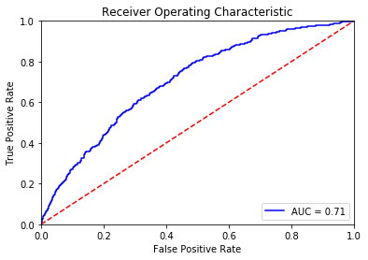
Results:
Logistic Regression:
Accuracy = 95.91 Optimal threshold = 0.15

Slide 13
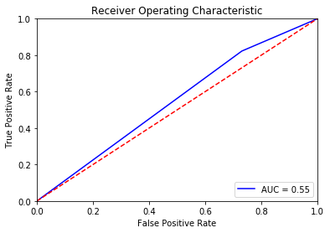
Decision Tree:
Accuracy = 26.99 Optimal Threshold = 1.0

Slide 14
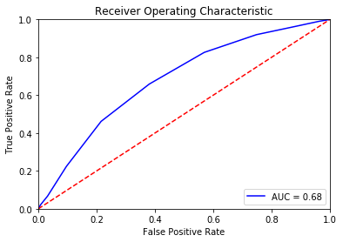
Random Forest:
Accuracy = 78.43 Optimal Threshold = 0.5

Slide 15
Thank You…!!!

